Slide 1
Chapter 24
Organic and biological chemistry

Slide 2




1. If each of the following represents a cycloalkanes, and a carbon atom is located at each vertex with the proper number of hydrogen atoms also bonded to it, which one is the most reactive? ________
A) B)
C) D)
D

Slide 3
2. How many isomers are possible for C₅H₁₂? ________
A) 1
B) 2
C) 3
D) 4
E) 10
C

Slide 4
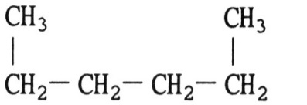
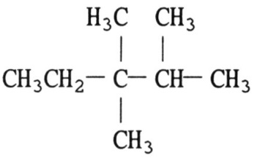
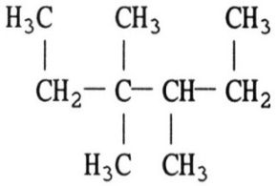
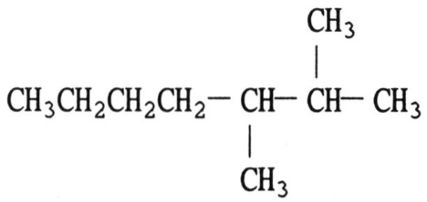
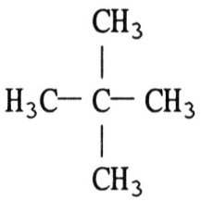
3. The structure of 2,3-dimethylheptane is ________.
A) B)
C) D)
E)
D

Slide 5
4. Which statement about hydrocarbons is false? ________
A) The smallest alkane to have structural (constitutional) isomers has 4 carbon atoms.
B) Cyclic alkanes are structural isomers of alkenes.
C) Alkanes are more reactive than alkenes.
D) Alkanes can be produced by hydrogenating alkenes.
E) Alkenes can be polymerized.
C

Slide 6
5. Benzene behaves differently from a hydrocarbon which simply contains three C=C bonds in that the latter would be expected to react much more readily with ________.
A) H₂
B) Cl₂
C) Br₂
D) HCl
E) all of the above
E

Slide 7
A
6. How many chiral centers are there in CH3CHCHCH2CHBr2? ________
A) 0
B) 1
C) 2
D) 3
E) 4

Slide 8
7. Sugars are examples of what type of molecule? ________
A) proteins
B) carbohydrates
C) nucleic acids
D) amino acids
E) salts
B

Slide 9
8. The double helix of DNA is stabilized mainly by ________.
A) ionic bonds
B) covalent bonds
C) ion-dipole bonds
D) ester bonds
E) hydrogen bonds
E

Slide 10
9. Which of the following compounds do not contain an sp3 hybridized oxygen atom? ________
A) ketones
B) alcohols
C) ethers
D) esters
E) water
A

Slide 11
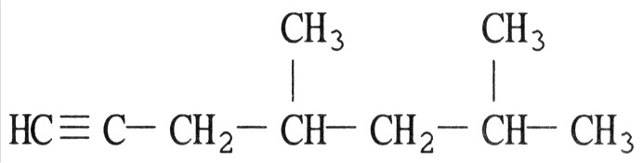
10. Give IUPAC names for the following compounds.
a.
b.
Answer:
a. 4,6-dimethyl-1-heptyne
b. 2,5-octadiene
CH3CH2CH=CHCH2CH=CHCH3

